Slide 1


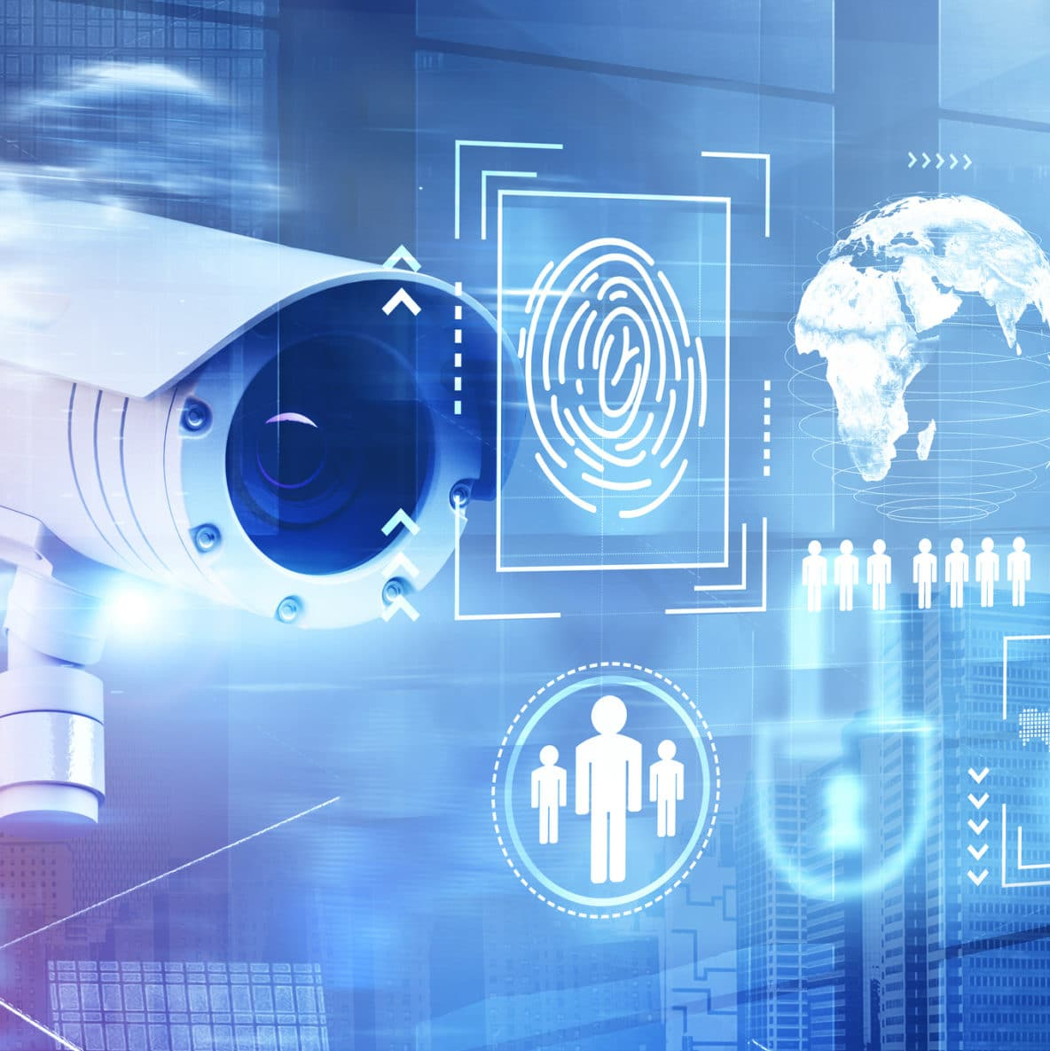
AIO(All in one) Home System

Slide 2
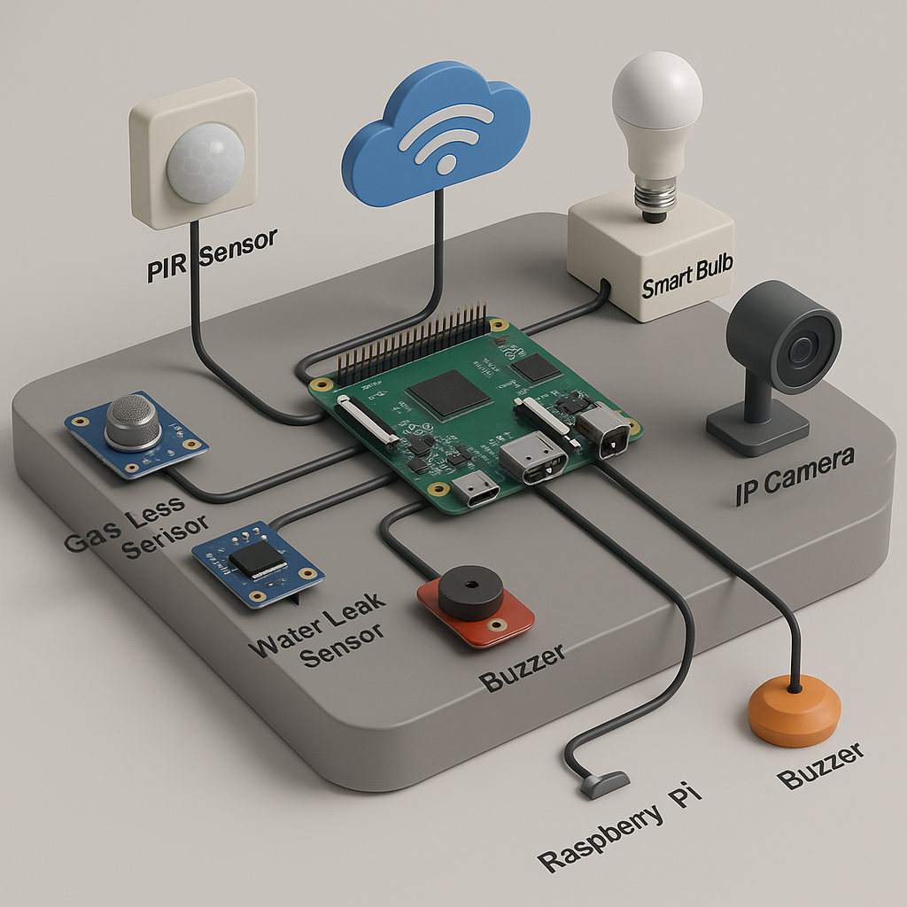

Slide 3
Importance of Surveillance Systems
Crime Prevention
& Deterrence
Surveillance cameras discourage criminal activities like theft, vandalism, and violence by creating a sense of monitored accountability. Studies show a significant drop in crime rates in areas with visible surveillance.
1
Enhanced Public &
Personal Safety
From traffic monitoring to crowd control, surveillance systems help authorities respond faster to accidents, emergencies, and threats, protecting both public spaces and private property.
2
Evidence Collection
& Accountability
High-quality footage provides critical evidence for solving crimes, resolving disputes, and ensuring transparency in workplaces, legal cases, and security investigations.
3

Slide 4
Role of facial Recognition and AI in Security
1. Face Detection
AI detects human faces in images or video streams using computer vision.
Deep learning algorithms (e.g., CNNs) help locate faces even in poor lighting or at different angles.
1
2.Face Matching & Identification
AI compares captured faces against databases for verification (e.g., unlocking a phone) or identification
(e.g., finding a suspect).Common uses: law enforcement, airport security, phone unlocking, workplace
access control.
.
2
3. Liveness Detection
AI systems verify that the face is from a real, live person (not a photo or mask) to prevent spoofing.
.
3
4.Emotion & Behavior Analysis
Some systems go beyond identity to assess emotional state, attention level, or suspicious behavior —
often controversial.
4

Slide 5
LITERATURE REVIEW
Title: AIO ( All in one home system)
Introduction:
The emergence of smart surveillance systems is closely tied to advancements in embedded systems, wireless communication, and artificial intelligence. Traditional surveillance has evolved into intelligent systems capable of automating security tasks using machine learning, IoT devices, and sensor fusion. Face recognition has become a pivotal element in modern surveillance due to its non-invasive and real-time identity verification capabilities.
Findings:
1.Face Recognition in Surveillance
Face recognition technology employs computer vision and deep learning models to identify individuals in real time. According to Zhang et al. (2019), the accuracy of modern face recognition algorithms has significantly improved with convolutional neural networks (CNNs), enabling reliable identity matching in varied lighting and background conditions. Integration with surveillance systems allows for automatic intruder detection, access control, and suspect tracking without manual intervention.

Slide 6
2. Raspberry Pi in IoT-Based Security Systems
The Raspberry Pi has emerged as a cost-effective and flexible platform for home automation and surveillance applications. As noted in the AIO Home System project, the Raspberry Pi acts as a central processing hub, interfacing with various sensors (PIR, gas, water leak) and peripherals (IP camera, smart bulbs). Prior studies (e.g., Sharma et al., 2020) demonstrate that Raspberry Pi-based systems offer a viable alternative to expensive proprietary setups, especially when paired with open-source software.
3. Sensor Integration for Home Safety
Effective surveillance systems go beyond visual monitoring. The integration of gas leak detectors, PIR sensors, and water leak sensors significantly enhances the functional scope of home security. These sensors provide environmental awareness, enabling early warning systems for hazards. Literature supports the use of multimodal sensor inputs to increase situational awareness (Li & Wang, 2018).
4. Smart Lighting and Energy Efficiency
Smart lighting systems, controlled by motion detection sensors, reduce energy consumption while improving home security. Studies such as those by Kumar et al. (2021) confirm the benefits of motion-triggered lighting in residential settings, not only in terms of energy savings but also in deterring unauthorized movement during nighttime.

Slide 7
Challenges and Limitations
Despite their advantages, smart surveillance systems face challenges such as data privacy, cybersecurity threats, and network dependency. Face recognition, in particular, raises ethical concerns related to consent and potential misuse. Furthermore, system reliability can be impacted by power failures or connectivity issues, especially when critical sensors are only Wi-Fi dependent.
Conclusion
The literature supports the effectiveness of integrating face recognition with sensor-based smart surveillance systems. Projects like the AIO Home System exemplify practical implementations of this technology, offering a blueprint for secure, energy-efficient, and automated home environments. Continued research and development will address current limitations while expanding capabilities in intelligent surveillance and home automation.

Slide 8
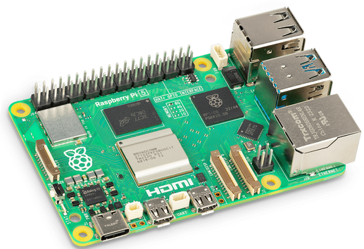
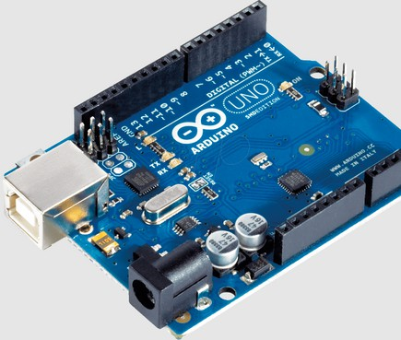
Devices used
Raspberry pi 4
Central processing unit of the system
Runs face recognition and surveillance and application
Arduino Uno
Handles basic sensor readings and real-time actions like buzzer control.
Provides fast and reliable signal processing for individual components. Offloads work from Raspberry Pi for quicker response.

Slide 9
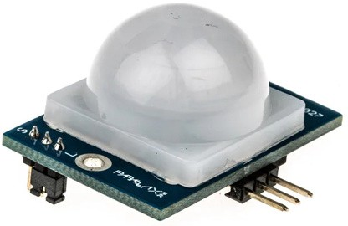
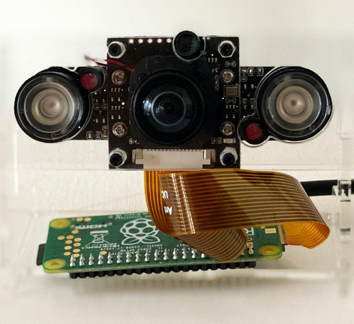
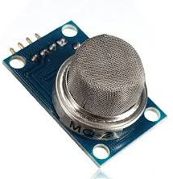
3. PIR Sensor (Passive Infrared Sensor)
Detects human motion for intruder alert.
Triggers the buzzer and sends signals to Raspberry Pi. Enhances both security and energy efficiency.
IP Camera
Provides live video surveillance of home.
Helps in face recognition and security monitoring.
Buzzer
Emits sound alert for gas leak, water leak, or intruder detection.
Activated by Arduino or Raspberry Pi based on sensor inputs. Provides immediate physical alert inside the house.

Slide 10
Working Mechanism
Smart Surveillance System with Face Recognition (AIO Home System)

Slide 11
Description of the Approach Used :
Video Input Capture
Source: CCTV camera, IP camera, or webcam.
Method: Real-time video streaming or recorded footage is captured frame by frame for processing.
2. Face Detection
Purpose: To identify and locate faces within a frame.
Techniques Used:
Haar Cascades (OpenCV): Lightweight and fast, suitable for real-time detection but less accurate.
DNN-based Detectors (e.g., YOLO model trained on google colab): Deep learning-based models for more robust and accurate face detection.
3. Face Alignment (Optional but Recommended)
Purpose: Normalize the face orientation (frontal view) to improve recognition accuracy.
Method: Detect facial landmarks (eyes, nose, mouth) and align the face using affine transformations.
4. Feature Extraction
Purpose: Extract unique facial features to represent the face mathematically.
Techniques Used:
Dlib, Open-CV, YOLO: Pre-trained deep learning models that convert the face into a fixed-length embedding vector.
5. Database Management
Storage: Embeddings and associated identity data are stored in a structured database (e.g., SQLite, MySQL, or NoSQL databases).
Updating: New faces can be added dynamically with their embeddings.
6. Alert System / Action Trigger
Real-Time Alerts: If an unauthorized or blacklisted individual is detected, the system triggers alerts (e.g., SMS, email, sound alarm).
Logging: Events are logged with timestamp, recognized identity, and snapshot of the face.

Slide 12
Tools, Technologies, and Hardware Used :
To build and deploy the system, we used the following tools and technologies:
Python: The primary programming language used for developing the system. It offers a wide range of libraries for computer vision and machine learning. We have used the python 3.12 in the project and the IDE as Pycharm community version.
OpenCV: An open-source computer vision library used for image processing tasks, such as capturing images, detecting objects, and manipulating video streams.
YOLO (You Only Look Once): A state-of-the-art object detection algorithm that allows real-time detection of faces in the video feed. We used a pre-trained YOLO model to detect the presence of human face and objects. We have used yolov8l model in our project.

Slide 13
Face/object Detection Algorithm:
We have used CNN-based Detectors (YOLO)
High accuracy; suitable for real-time face detection.
YOLO is commonly used in smart surveillance for detecting multiple faces simultaneously.
YOLO stands for You Only Look Once
How YOLO works:
Single Pass Detection: Unlike traditional methods that apply a classifier to multiple regions of an image, YOLO divides the image into a grid and predicts bounding boxes and class probabilities for each grid cell in a single pass.
Fast and Efficient: YOLO is designed to be fast and efficient, making it suitable for real-time applications.
End-to-End Training: The entire model is trained end-to-end to predict both bounding boxes and class probabilities directly from the image pixels.
High Accuracy: YOLO achieves high accuracy in detecting objects, even in complex scenes

Slide 14
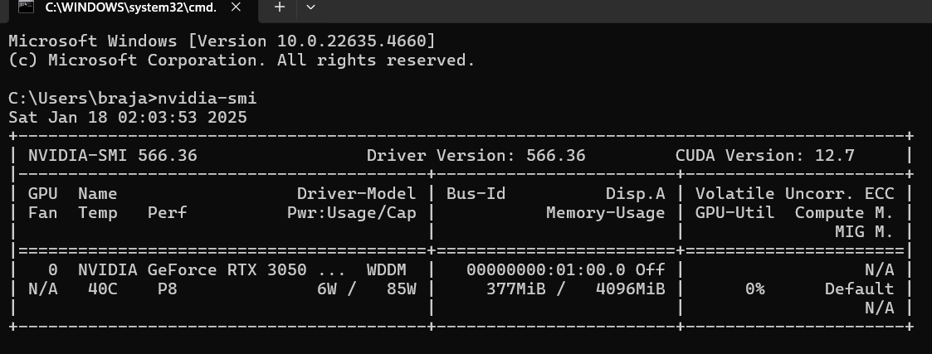
CUDA Deep Neural Network (cuDNN):
It is a GPU-accelerated library developed by NVIDIA. It provides highly optimized implementations for standard routines used in deep neural networks, such as forward and backward convolution, attention, matrix multiplication (matmul), pooling, and normalization. cuDNNis widely used in deep learning frameworks to speed up training and inference, making it an essential tool for tasks like computer vision, conversational AI, and recommendation systems.We have to install nvidia toolkit and its latest driver version for utilizing the efficiency. We used cuda version 12.7 in the project.

Slide 15

Real-time Notification System
Audible Alarm Feature
An audible buzzer alerts users to immediate dangers, which enhances lhe urgency and prompts swift action during an emergency
The system provides real-time alerts to users mobile devices when threats are detected, ensuring they are instantly informed
Email Notifications
Homeowners receive email notifications about potential threats, allowing for monitoring even
when away from home
user Empowerment
This alert system empowers users 1o ac1 swiftly by keeping them informed about potential
threats in real-lime
Multi-faceted Approach
Combining mobile alerts, audible alarms, and email notifications creates a multi-faceted alert system that maximizes user awareness

Slide 16
Model Architecture
The core of the system is a Convolutional Neural Network (CNN) architecture, which is particularly suited for tasks that involve image recognition. CNNs consist of the following layers:
Convolutional Layers: These layers apply filters to input images to extract essential features, such as edges and textures, which are used to detect whether an object is present.
Pooling Layers: These layers reduce the spatial dimensions of the feature maps, making the model more computationally efficient while retaining important features.
Fully Connected Layers: These layers process the extracted features and classify them into different objects categories.
In this project, we used YOLOv8l as a custom-trained model, fine-tuned on a dataset of workers in industrial settings to detect helmets. The model was trained to recognize helmets in various conditions, such as different angles, lighting conditions, and distances. Also we use Nvidia’s CUDA dnn which is based on deep neural network for faster response.

Slide 17
Thanks!
Do you have any questions?

